Slide 1
Convolutional Neural Networks

Slide 2
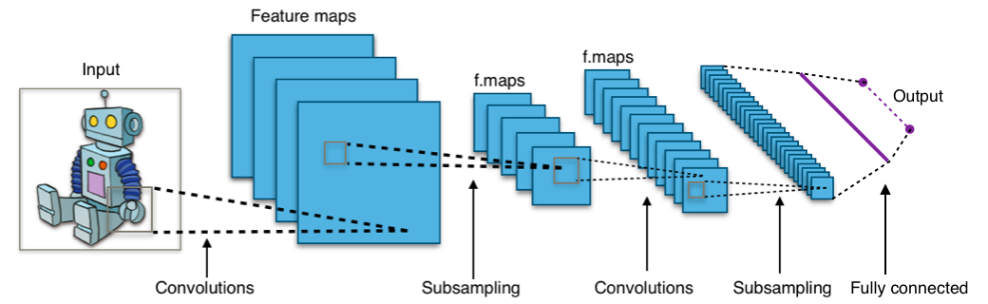
Convolutional Neural Network
What is the Convolutional Neural Network?
Consists of Convolution, Pooling layers

Slide 3
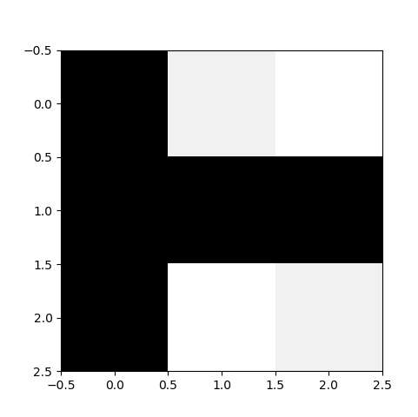
Convolution
How to operate (1)
import tensorflow as tf import os os.environ['CUDA_VISIBLE_DEVICES'] = "0" config = tf.ConfigProto() config.gpu_options.per_process_gpu_memory_fraction = 0.4 import numpy as np
# import matplotlib.pyplot as plt init = tf.global_variables_initializer() sess = tf.Session() sess.run(init) image = np.array([[[[9], [1], [0]], [[9], [9], [9]], [[9], [0], [1]]]], dtype=np.float32) print('image.shape', image.shape) # plt.imshow(image.reshape(3,3), cmap='Greys’) # plt.show()
print(image.reshape(3,3))

Slide 4
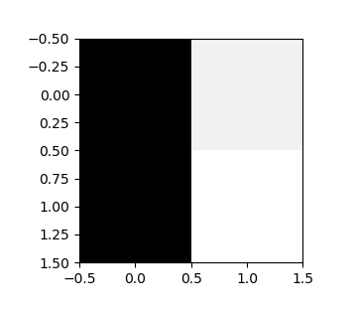
Convolution
How to operate (2-1) - VALID
weight = tf.constant([[[[1.]], [[0.]]], [[[1.]], [[0.]]]]) print('weight.shape', weight.shape)
print(weight.eval(session=sess).reshape(2,2))
conv2d = tf.nn.conv2d(image, weight, strides=[1, 1, 1, 1], padding='VALID') conv2d_img = conv2d.eval(session=sess) print('conv2d_img.shape', conv2d_img.shape) print(conv2d_img.reshape(2,2))
# for i, one_img in enumerate(conv2d_img): # print(one_img.reshape(conv2d_img.shape[1],conv2d_img.shape[2])) # plt.subplot(1, 2, i+1), plt.imshow(one_img.reshape(conv2d_img.shape[1],conv2d_img.shape[2]), cmap='Greys’) # plt.show()
sess.close()

Slide 5
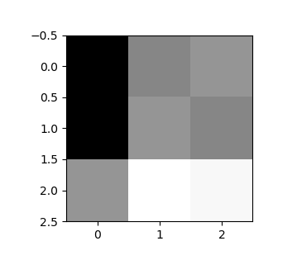
Convolution
How to operate (2-2) - SAME
weight = tf.constant([[[[1.]], [[0.]]], [[[1.]], [[0.]]]]) print('weight.shape', weight.shape)
print(weight.eval(session=sess).reshape(2,2))
conv2d = tf.nn.conv2d(image, weight, strides=[1, 1, 1, 1], padding=’SAME') conv2d_img = conv2d.eval(session=sess) print('conv2d_img.shape', conv2d_img.shape) print(conv2d_img.reshape(3,3))
# for i, one_img in enumerate(conv2d_img): # print(one_img.reshape(conv2d_img.shape[1],conv2d_img.shape[2])) # plt.subplot(1, 2, i+1), plt.imshow(one_img.reshape(conv2d_img.shape[1],conv2d_img.shape[2]), cmap='Greys’) # plt.show()
sess.close()

Slide 6
Convolution
https://github.com/vdumoulin/conv_arithmetic
Summary (1)
Padding=‘VALID’, Strides=1
Padding=‘SAME’, Strides=1
Padding=‘VALID’, Strides=2
Padding=‘VALID’, Strides=2

Slide 7
Convolution
Summary (2)
https://medium.com/@phidaouss/convolutional-neural-networks-cnn-or-convnets-d7c688b0a207

Slide 8
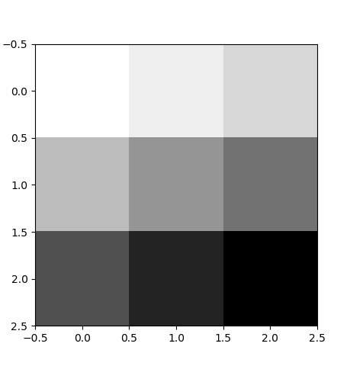
Pooling
How to operate (1)
import tensorflow as tf import os os.environ['CUDA_VISIBLE_DEVICES'] = "0" config = tf.ConfigProto() config.gpu_options.per_process_gpu_memory_fraction = 0.4 import numpy as np # import matplotlib.pyplot as plt init = tf.global_variables_initializer() sess = tf.Session() sess.run(init) image = np.array([[[[1], [2], [3]], [[4], [5], [6]], [[7], [8], [9]]]], dtype=np.float32) print('image.shape', image.shape)
# plt.imshow(image.reshape(3,3), cmap='Greys’) # plt.show()
print(image.reshape(3,3))

Slide 9
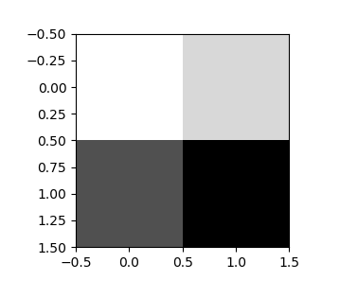
Pooling
How to operate (2-1) - VALID
pool = tf.nn.max_pool(image, ksize=[1, 2, 2, 1], strides=[1, 1, 1, 1], padding='VALID') pool_img = pool.eval(session=sess) print('pool_img.shape', pool.shape) print(pool_img.reshape(2,2))
# for i, one_img in enumerate(pool_img): # print(one_img.reshape(pool_img.shape[1],pool_img.shape[2])) # plt.subplot(1, 2, i+1), plt.imshow(one_img.reshape(pool_img.shape[1],pool_img.shape[2]), cmap='Greys’) # plt.show()
sess.close()

Slide 10
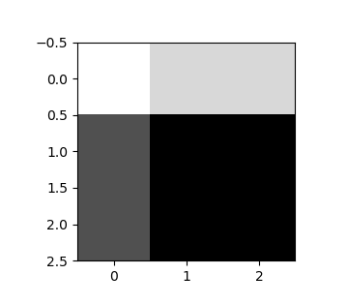
Pooling
How to operate (2-2) - SAME
pool = tf.nn.max_pool(image, ksize=[1, 2, 2, 1], strides=[1, 1, 1, 1], padding='SAME') pool_img = pool.eval(session=sess) print('pool_img.shape', pool.shape) print(pool_img.reshape(3,3))
# for i, one_img in enumerate(pool_img): # print(one_img.reshape(pool_img.shape[1],pool_img.shape[2])) # plt.subplot(1, 2, i+1), plt.imshow(one_img.reshape(pool_img.shape[1],pool_img.shape[2]), cmap='Greys’) # plt.show()
sess.close()

Slide 11
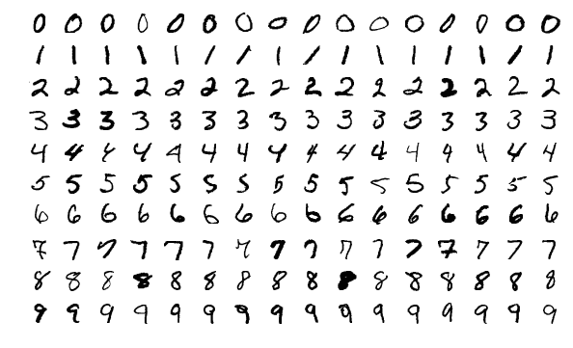
CNN for MNIST
MNIST Dataset
Large data of handwritten digits that is commonly used for training various image processing systems and machine learning
It contains 60,000 training images and 10,000 testing images (28 X 28 pixel)

Slide 12
CNN for MNIST
Preparation
MNIST dataset download and load to mnist variable with one_hot label encoding
A image consists of 784 pixels (28X28X1)
A label consists of 10 classes (0 – 9)
First dimension (None) will index the images in the mini-batch
import tensorflow as tf import os os.environ['CUDA_VISIBLE_DEVICES'] = "0" config = tf.ConfigProto() config.gpu_options.per_process_gpu_memory_fraction = 0.4 from tensorflow.examples.tutorials.mnist import input_data mnist = input_data.read_data_sets("./dataset/mnist/", one_hot=True) X = tf.placeholder(tf.float32, [None, 28, 28, 1]) Y = tf.placeholder(tf.float32, [None, 10])

Slide 13
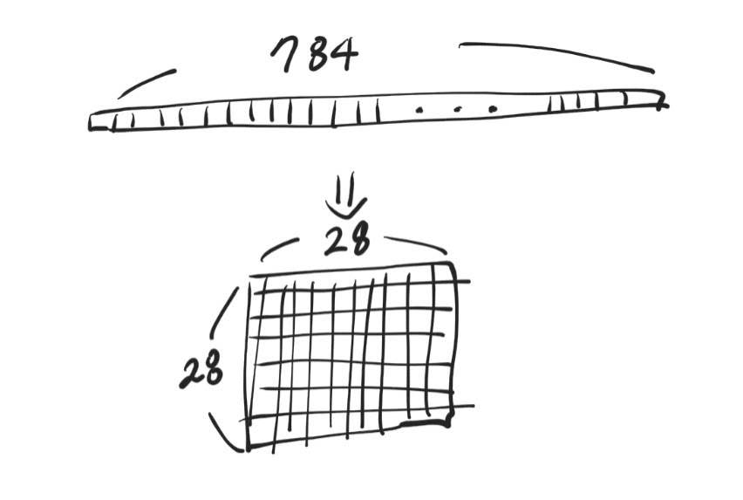
CNN for MNIST
Convert Image format
A image consists of 784 pixels , but image format for CNNs is 28 X 28 X 1 (width X height X channels)
X_image = tf.reshape(X, [-1,28,28,1])

Slide 14
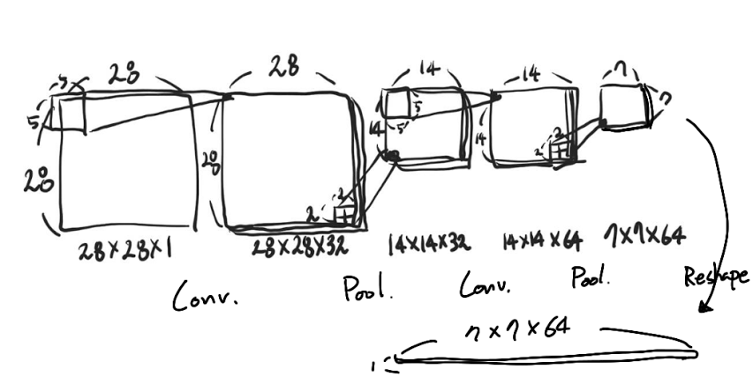
CNN for MNIST
Setup Layers (1)
Conv2d
Filter: 5X5X32
Strides: 1, Padding: Same
Pooling
Size: 2X2
Strides: 2, Padding: Same
W1 = tf.Variable(tf.random_normal([5, 5, 1, 32], stddev=0.01)) L1 = tf.nn.relu(tf.nn.conv2d(X_image, filter=W1, strides=[1, 1, 1, 1], padding='SAME')) L1 = tf.nn.max_pool(L1, ksize=[1, 2, 2, 1], strides=[1, 2, 2, 1], padding='SAME')

Slide 15
CNN for MNIST
Setup Layers (2)
Conv2d
Filter: 5X5X64
Strides: 1, Padding: Same
Pooling
Size: 2X2
Strides: 2, Padding: Same
Reshape
7X7X64 to 3,136
W2 = tf.Variable(tf.random_normal([5, 5, 32, 64], stddev=0.01)) L2 = tf.nn.relu(tf.nn.conv2d(L1, filter=W2, strides=[1, 1, 1, 1], padding='SAME')) L2 = tf.nn.max_pool(L2, ksize=[1, 2, 2, 1], strides=[1, 2, 2, 1], padding='SAME') L2 = tf.reshape(L2, [-1, 7 * 7 * 64])

Slide 16
CNN for MNIST
Setup Layers (3)
Fully-connected Layer for Classification
512 nodes
W3 = tf.Variable(tf.random_normal([7 * 7 * 64, 512], stddev=0.01)) L3 = tf.nn.relu(tf.matmul(L2, W3)) W4 = tf.Variable(tf.random_normal([512, 10], stddev=0.01)) B4 = tf.Variable(tf.random_normal(shape=[10], stddev=0.01)) model = tf.nn.softmax(tf.matmul(L3, W4) + B4)

Slide 17
CNN for MNIST
Cost function and Optimizer
Initialize
cost = tf.reduce_mean(-tf.reduce_sum(Y * tf.log(tf.clip_by_value(model, 1e-10, 1.0)), [1]))
optimizer = tf.train.AdamOptimizer(0.001).minimize(cost)
init = tf.global_variables_initializer() sess = tf.Session(config=config) sess.run(init)

Slide 18
CNN for MNIST
Setup for mini-batch
Setup for Accuracy
batch_size = 100 total_batch = int(mnist.train.num_examples / batch_size)
is_correct = tf.equal(tf.argmax(model, 1), tf.argmax(Y, 1)) accuracy = tf.reduce_mean(tf.cast(is_correct, tf.float32))

Slide 19
CNN for MNIST
Training and Evaluation
for epoch in range(15): total_cost = 0 for i in range(total_batch): batch_xs, batch_ys = mnist.train.next_batch(batch_size) _, cost_val = sess.run([optimizer, cost], feed_dict={X: batch_xs, Y: batch_ys}) total_cost += cost_val print('Epoch:', '%04d' % (epoch + 1), 'Avg. cost =', '{:.3f}'.format(total_cost / total_batch))
print('Training Done!') print('Test Acc. = ', sess.run(accuracy, feed_dict={X: mnist.test.images, Y: mnist.test.labels}))
sess.close()

Slide 20
CNN for MNIST
Model | 5-layer ReLU+DO | 5-layer ReLU+DO+BN
Acc. | 0.9836 | 0.9834
Run!
Epoch: 0001 Avg. cost = 0.235
Epoch: 0002 Avg. cost = 0.059
Epoch: 0003 Avg. cost = 0.040
Epoch: 0004 Avg. cost = 0.028
Epoch: 0005 Avg. cost = 0.022
Epoch: 0006 Avg. cost = 0.018
Epoch: 0007 Avg. cost = 0.014
Epoch: 0008 Avg. cost = 0.010
Epoch: 0009 Avg. cost = 0.009
Epoch: 0010 Avg. cost = 0.009
Epoch: 0011 Avg. cost = 0.009
Epoch: 0012 Avg. cost = 0.007
Epoch: 0013 Avg. cost = 0.007
Epoch: 0014 Avg. cost = 0.005
Epoch: 0015 Avg. cost = 0.004
Training Done!
Test Acc. = 0.991

Slide 21
Practice: Add Dropout and Compare the performance
Code
…
keep_prob = tf.placeholder(tf.float32) …
L1 = tf.nn.dropout(L1, keep_prob) …
L2 = tf.nn.dropout(L2, keep_prob) …
L3 = tf.nn.dropout(L3, keep_prob)
…
_, cost_val = sess.run([optimizer, cost], feed_dict={X: batch_xs, Y: batch_ys, keep_prob: 0.7}) total_cost += cost_val …
print('Test Acc. = ', sess.run(accuracy, feed_dict={X: mnist.test.images, Y: mnist.test.labels, keep_prob: 1.0}))

Slide 22
Practice: Add Dropout and Compare the performance
Run!
Model | 5-layer ReLU+DO | 5-layer ReLU+DO+BN | CNN w/o Dropout
Acc. | 0.9836 | 0.9834 | 0.9910
Epoch: 0001 Avg. cost = 0.262
Epoch: 0002 Avg. cost = 0.078
Epoch: 0003 Avg. cost = 0.055
Epoch: 0004 Avg. cost = 0.045
Epoch: 0005 Avg. cost = 0.038
Epoch: 0006 Avg. cost = 0.033
Epoch: 0007 Avg. cost = 0.028
Epoch: 0008 Avg. cost = 0.026
Epoch: 0009 Avg. cost = 0.023
Epoch: 0010 Avg. cost = 0.022
Epoch: 0011 Avg. cost = 0.019
Epoch: 0012 Avg. cost = 0.018
Epoch: 0013 Avg. cost = 0.018
Epoch: 0014 Avg. cost = 0.017
Epoch: 0015 Avg. cost = 0.015
Training Done!
Test Acc. = 0.9936

